Slide 1
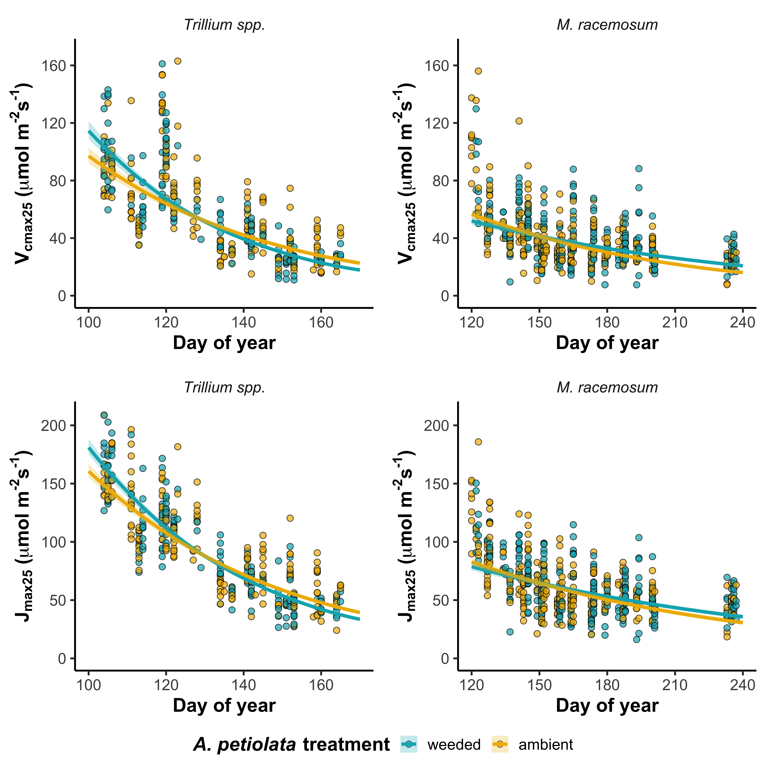
GM: p=0.765
DOY: p<0.001
GM*DOY: p=0.003
GM: p=0.484
DOY: p<0.001
GM*DOY: p=0.004
GM: p=0.898
DOY: p<0.001
GM*DOY: p=0.001
GM: p=0.583
DOY: p<0.001
GM*DOY: p=0.045

